Slide 1
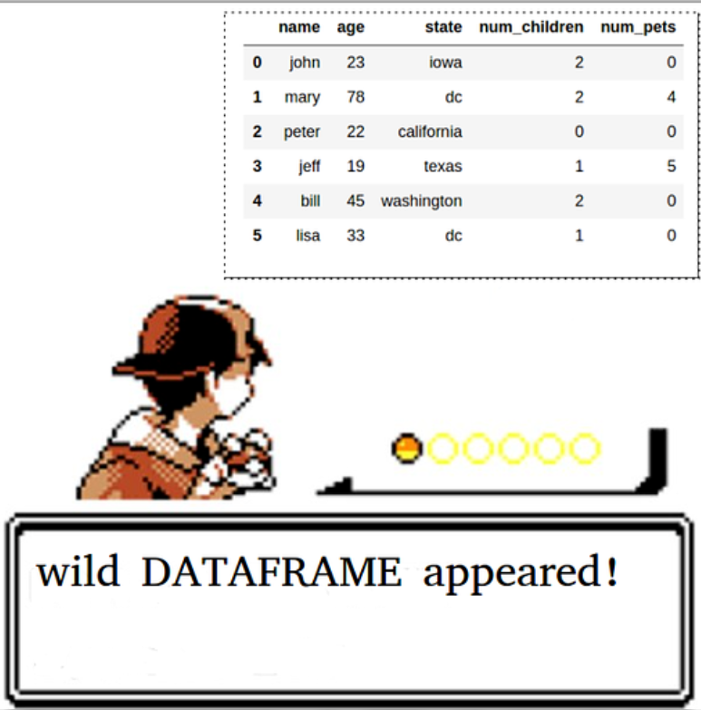
CISC 372 T1 Review

Slide 2

IT IS REWIND TIME
https://www.youtube.com/watch?v=YbJOTdZBX1g

Slide 3
E-mail Policy
When you send e-mail to me, put “CISC 372” in the subject area, so that it can pass the spam filter.
Visit me during my office hour if questions required extensive explanation. (or if you want to chat with me on something you are interested)
Course email list is a must-read.

Slide 4

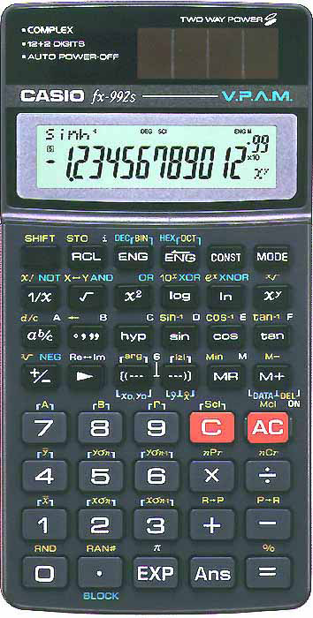
Calculator with “log” function
The following models are recommended.
CASIO
fx-100MS, fx-115MS,
fx-260, fx-570MS,
fx-991MS, fx-992S
SHARP
EL-510, EL-520,
EL-531, EL-546
Models extensions are acceptable.

Slide 5
Background (L1, L3)
Data Science – A new approach to understand/model unknown system
Empirical science, theoretical science, computational science
Security:
CIA for security evaluation
Security/Ethical implication of AI/DS

Slide 6
Experimental Protocol (L4)
Supervised vs. Unsupervised Learning (& semi-)
Classification vs. Prediction/Regression
Macro-average vs. Micro-average
Bias vs. variance
Overfitting vs. underfitting
Hold-out method (with validation set)
Purpose of different set
Cross-validation
.632 Boostrapping
Hyperparameter tuning (as a DS life cycle)

Slide 7
Understanding the data (L5)
Data attribute
Ordinal vs. categorical
Preprocessing
Normalization
Standardization
Discretization

Slide 8
Classifiers/Regressors (L2, L7-L11)
Know decision boundaries (what it may look like)
What are the limitations?
How to regularize (if any)?
Generative model/Discriminative model?
Eager learner/Lazy learner?
Parametric model/Non-parametric model?
Flexible/Inflexible (w.r.t. different hyperparameter)?
So you know what to do to reduce bias
You know what to do to reduce variance
Interpretability

Slide 9
Decision Tree[s] (for classification) L7-L8
How to create a node in a tree, given a dataset.
Calculator to calculate log with base 2
What is the problem of information gain?
How gain ratio solve this problem?
What are the metric used for selecting features?
ID3
CART
C4.5
How to handle numeric value attribute
Pre-pruning/Post-pruning
Random Forest vs Single Tree
Build-in bootstrapping

Slide 10
XGboost L9
Objective function?
Loss function + regularization
Difference compared to random forest?
Optimize tree selection toward an objective function
How does it regularize?
How to adjust its flexibility?

Slide 11
Neural Network (L10-L11)
CNN vs NN
Improvements
Pooling Layer vs Convolution Layer
GD
Stochastic GD (SGD) (1-sample/mini-batch)
Momentum
Adagrad:
Adaptive learning rate
Issues? Methods proposed to solve this issue.

Slide 12
Instance-based Learning & Naïve Bayesian L11
K-NN
What are the decisions one needs to make?
How to adjust flexibility
Naïve Bayesian
Generative model
Easy to implement
Require a smaller set of training data
Issue: class conditional independence

Slide 13
What is not covered?
Clustering
Partition-based clustering
No k-mean
No k-medoids
Density-based clustering
Feature Selection
Handling Missing Values
Naïve Bayesian
Semi-automated hyperparameter tuning

